Slide 1





Long First Exon and Broad H3K27ac Are Two Defining Features of Eutherian Conserved Pachytene piRNA Loci
Tianxiong Yu, Bo Xu, Zhongren Hu, Kaili Fan, Deniz Ozata, Gen Zhang
William E. Theurkauf*, Philip D. Zamore* and Zhiping Weng*
University of Massachusetts Chan Medical School
Apr 2022, the EMBO piRNA workshop
Notes:
Thanks for the introduction, I am Tianxiong Yu, a postdoc in Zhiping Weng’s lab at UMass Chan Medical School. I will present our work on pachytene piRNA genes in mammals, collaborated with the Zamore and Theurkauf labs.

Slide 2
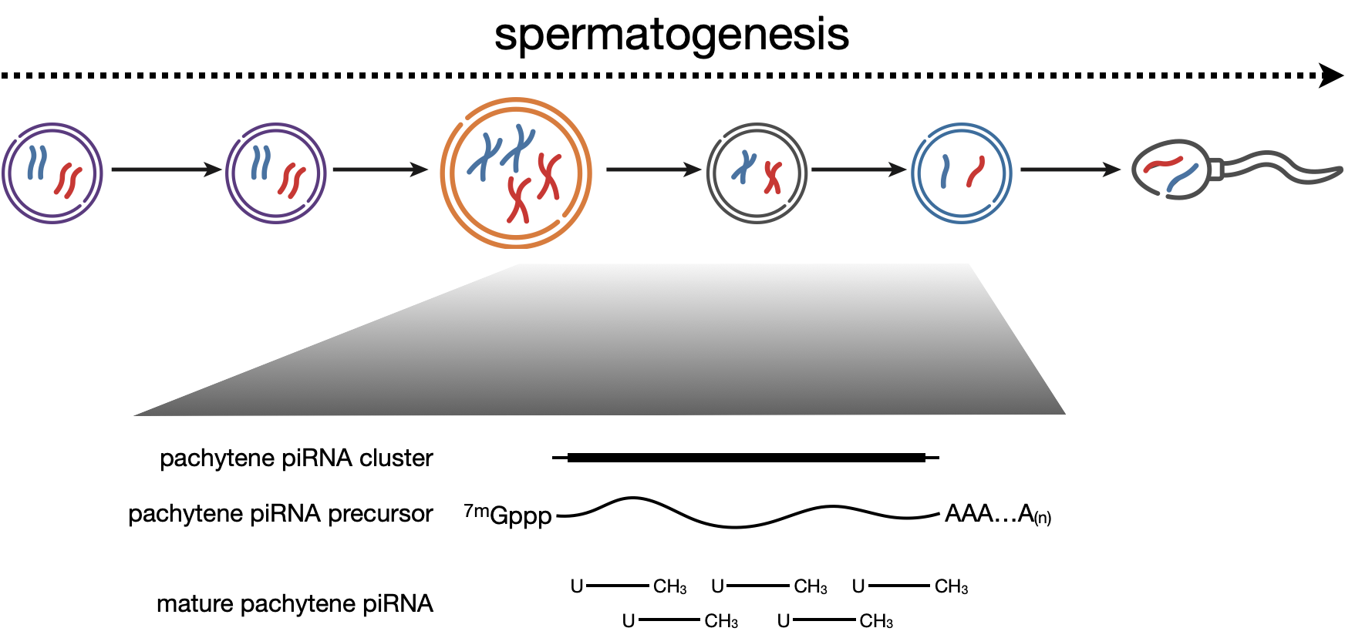
Pachytene piRNAs in mice derive from ~100 genes
Background
Girard et al., Nature, 2006
Lau et al., Science, 2006
Aravin et al., Nature, 2006
Li et al., Mol Cell, 2013
Gou et al., Cell Research, 2014
Ozata et al., Nature Review Genetics, 2019
Tianxiong Yu, Weng Lab
Apr 2022, the EMBO piRNA workshop
Notes:
A number of papers since 2006 have described highly abundant piRNAs produced at the pachytene stage of the spermatogenesis. These pachytene piRNAs are best characterized in mouse testes, where they are derived from roughly 100 genomic loci. These loci are transcribed by RNA Pol II, spliced if there are introns, capped and poly-adenylated, and then processed into mature piRNAs.

Slide 3
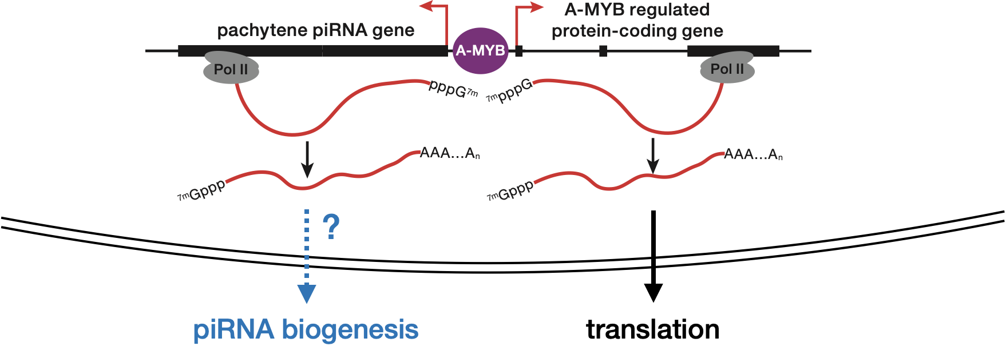
What causes pachytene piRNA genes to produce piRNAs?
Background
Besides A-MYB, what features regulate the transcription of pachytene piRNA genes?
2. What determines which transcripts can be steered into the piRNA pathway?
Tianxiong Yu, Weng Lab
Apr 2022, the EMBO piRNA workshop
Notes:
As we know, A-MYB is a transcription factor for most pachytene piRNA genes in mice; however, A-MYB also regulate many protein-coding genes.
We then asked if there is any additional features that regulate the transcription of pachytene piRNA genes and distinguish piRNA precursor transcripts from typical mRNAs.

Slide 4
Half of mouse pachytene piRNA genes have long first exons
Results
Yu and Fan et al., Nature Communications, 2021
Tianxiong Yu, Weng Lab
Apr 2022, the EMBO piRNA workshop
Notes:
The most important genetic feature we found is first exon length.
Most protein-coding genes are spliced, and their first exons are 2-3 hundred nucleotides long. The Zamore lab accurately defined the exon-intron structures of the 100 pachytene piRNA genes in mice. And surprisingly, 39 of them are intronless and longer than 10 kb and 9 of them are spliced but their first-exon are also longer than 10 kb. And we then call these genes as long first exon genes.

Slide 5
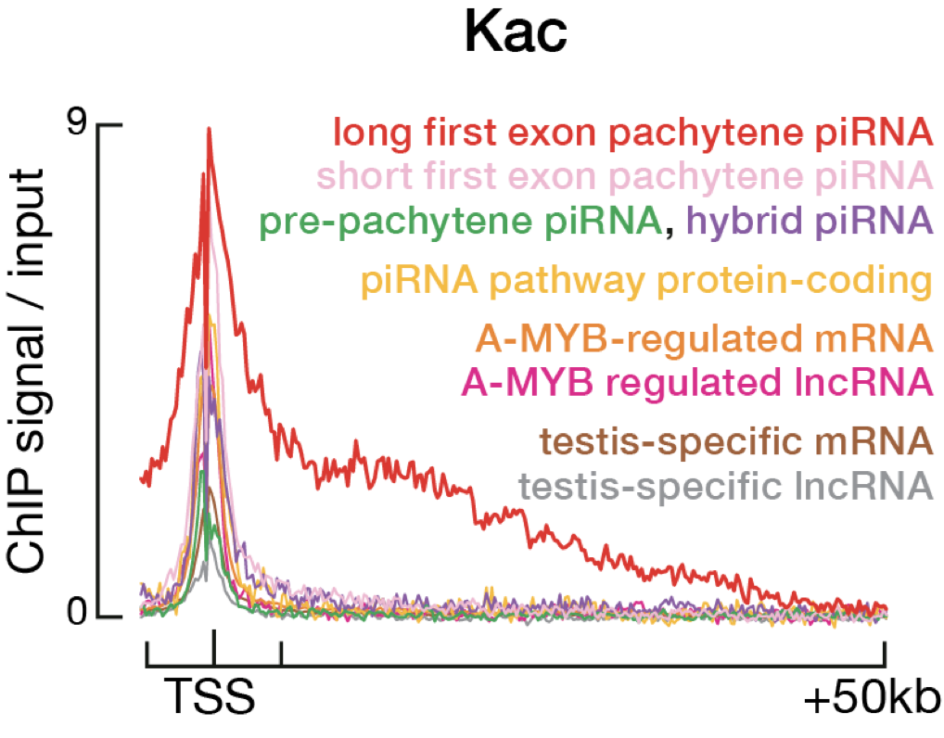
Long-first-exon pachytene piRNA genes show broad histone acylation
Results
Pachytene piRNA genes
| 3´ end of first exon
| 3´ end of pachytene piRNA gene
Yu and Fan et al., Nature Communications, 2021
Tianxiong Yu, Weng Lab
Apr 2022, the EMBO piRNA workshop
Notes:
The we asked how about the epigenetic features, and further observed that the long-first-exon pachytene piRNA genes show broad histone acylation. On the left panel, the 100 pachytene piRNA genes are sorted by the length of their first exons, marked with a black bar. You can see that histone lysine acetylation starts from the TSS of each gene and extends to the end of the first exon. The aggregation plot on the right contrasts long-first-exon pachytene genes, in red, with all other classes of genes for which histone acetylation is focused only at the promoter.

Slide 6
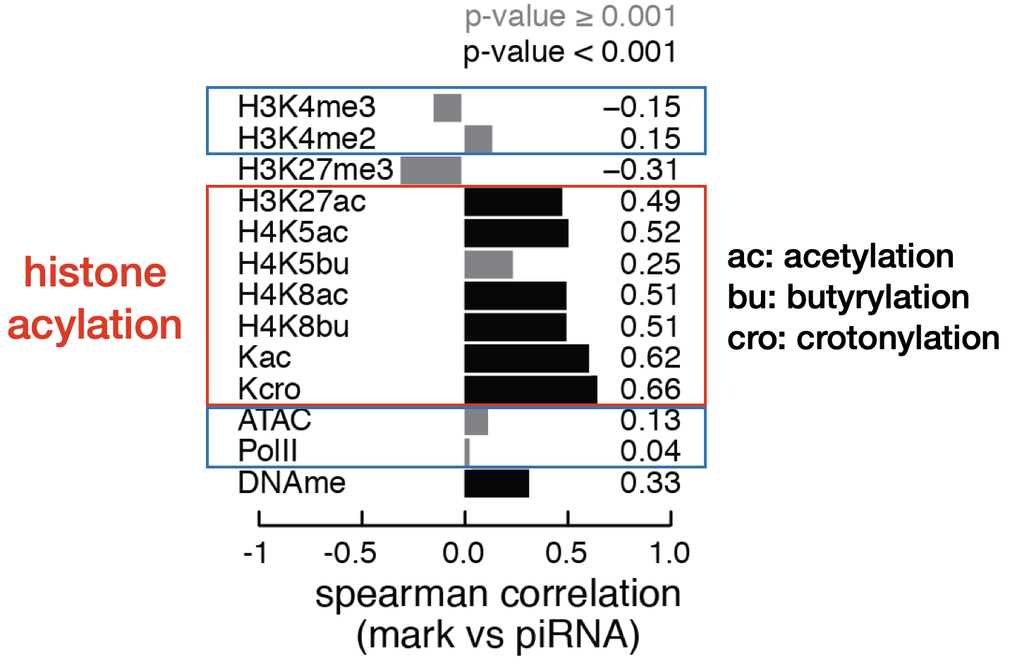
Histone acylation correlates with piRNA level
Results
Yu and Fan et al., Nature Communications, 2021
Tianxiong Yu, Weng Lab
Apr 2022, the EMBO piRNA workshop
Notes:
In fact, the level of histone acylation in the first exon of a pachytene piRNA gene is highly correlated with the amount of piRNAs been produced.

Slide 7
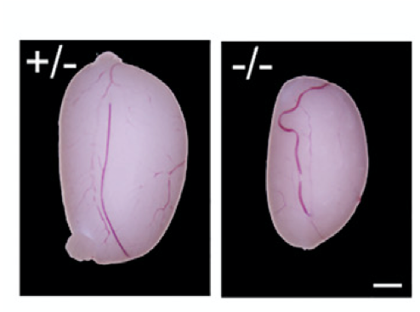
BTBD18 is essential for the elongation of half pachytene piRNA genes
Background
BTBD18 mutant mouse testes
Zhou et al. Developmental Cell, 2017
Tianxiong Yu, Weng Lab
Apr 2022, the EMBO piRNA workshop
Notes:
Beside histone acylation, there are some other factors interact with the long first exon. Zhou et al. reported previously that BTBD18 is required for the transcription at roughly half of pachytene piRNA genes.

Slide 8
Long-first-exon pachytene piRNA genes are BTBD18 dependent
Results
Yu and Fan et al., Nature Communications, 2021
Tianxiong Yu, Weng Lab
Apr 2022, the EMBO piRNA workshop
Notes:
And we found the pachytene piRNA genes dependent on BTBD18 coincide almost precisely with our set of long-first-exon genes.

Slide 9
THO complex steers precursor piRNA transcripts
Background
Zhang and Tu et al. Cell Rep, 2018
Hur et al. Genes Dev, 2016
Zhang et al. Cell, 2014
Mohn et al. Cell, 2014
Tianxiong Yu, Weng Lab
Apr 2022, the EMBO piRNA workshop
Notes:
Several labs have shown that the THO complex is required in fly ovaries for shuttling piRNA precursor transcripts out of the nucleus for processing into mature piRNAs.

Slide 10
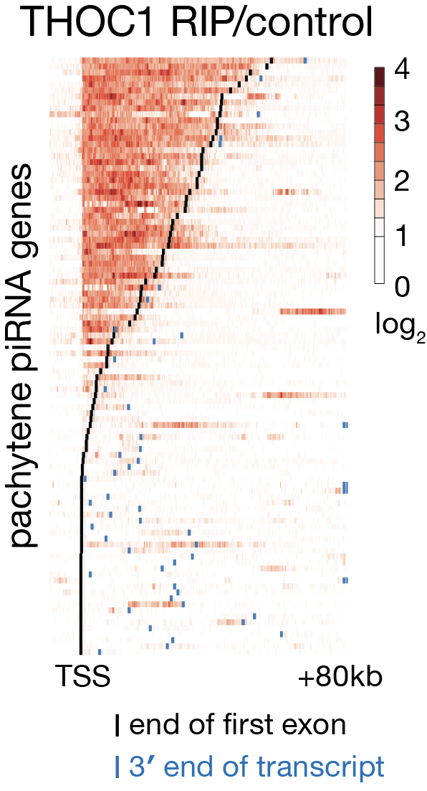
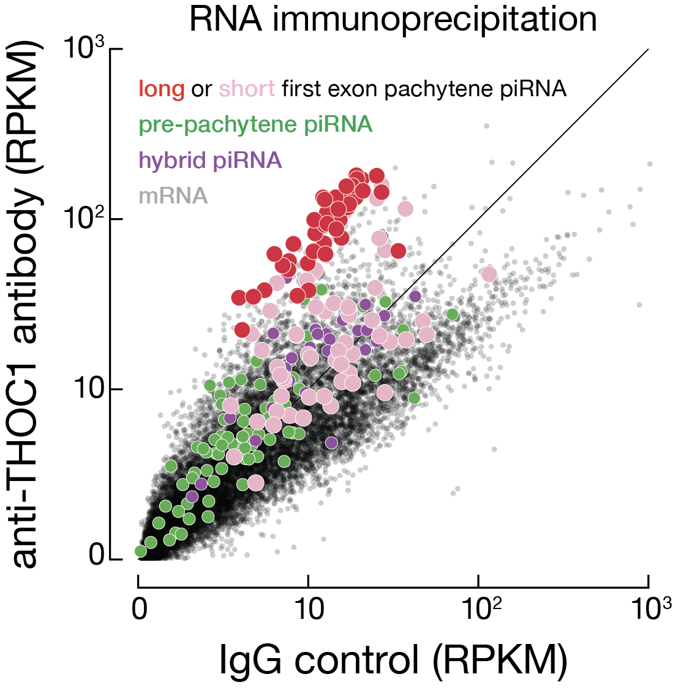
THO complex specifically binds long-first-exon piRNA transcripts
Results
Pachytene piRNA genes
Yu and Fan et al., Nature Communications, 2021
Tianxiong Yu, Weng Lab
Apr 2022, the EMBO piRNA workshop
Notes:
Gen in the Theurkauf lab performed RIP-seq in in mouse testis for THOC1 and THOC2, which are two components of the THO complex. We found the long-first exon pachytene piRNA genes are highly enriched in THO binding. The left panel shows THOC1 RIP signal in the long first exons and the scatter plot on the right shows that the long-first-exon pachytene piRNA transcripts in red are the only set of transcripts enriched for THO binding.

Slide 11
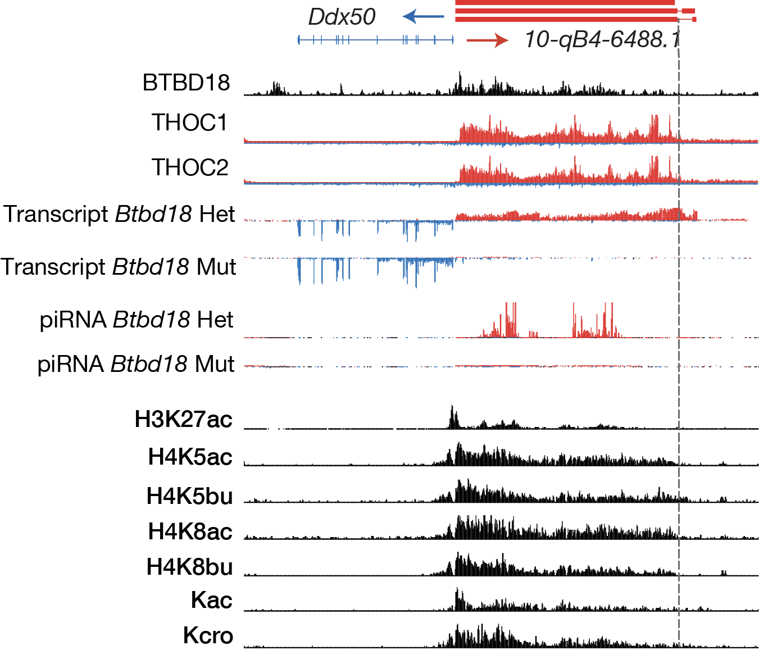
Long-first-exon, histone acylation, THO binding define pachytene piRNA genes
Results
Yu and Fan et al., Nature Communications, 2021
Tianxiong Yu, Weng Lab
Apr 2022, the EMBO piRNA workshop
Notes:
Here is an example that compares two divergently transcribed genes. A spliced, long-first-exon pachytene piRNA gene is transcribed to the right. It is bound by BTBD18 and covered with histone acylatio. Its transcript is bound by THOC, and it produces a lot of piRNAs, which disappear in Btbd18 mutant. A protein-coding gene Ddx50 transcribes to the left, which has a short first exon and does not have any of the above features and makes no piRNA.

Slide 12
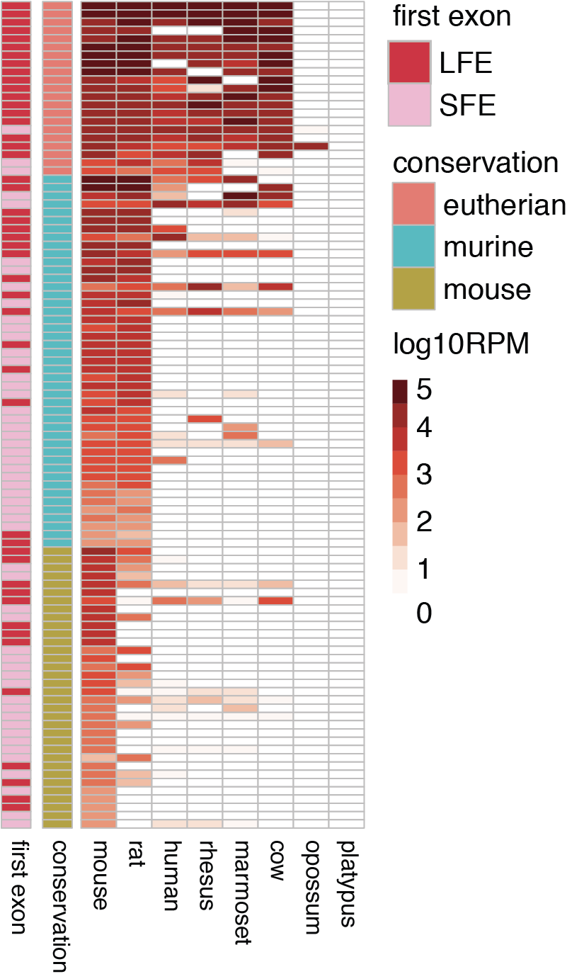
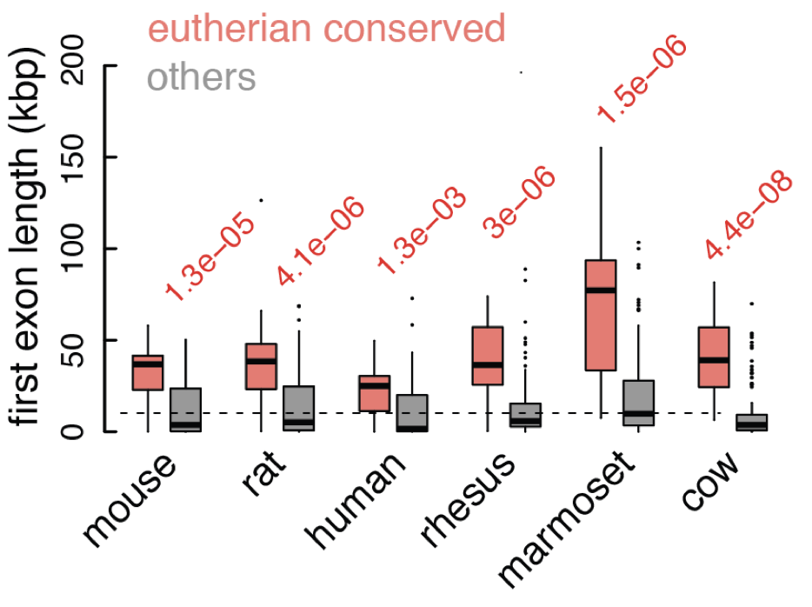
Long-first-exon pachytene piRNA genes are conserved among eutherian mammals
Results
piRNA abundance
Pachytene piRNA genes
Yu and Fan et al., Nature Communications, 2021
Tianxiong Yu, Weng Lab
Apr 2022, the EMBO piRNA workshop
Notes:
Actually, most of the 48 long-first-exon pachytene piRNAs in mouse are conserved in other eutherian mammals, and their syntenic regions also produce a lot of piRNAs in the other mammals. We called piRNA clusters using long and small RNA-seq data in adult testes of the other mammals and found that long-first-exon is an evolutionarily conserved feature.

Slide 13
Define pachytene piRNA genes in mammalian testes
Methods
xxx
Tianxiong Yu, Weng Lab
Apr 2022, the EMBO piRNA workshop
Notes:
Just after we published our paper, another study has been published and provided RNA-seq, H3K27ac and H3K4me3 ChIP-seq data in the adult testes of eight additional eutherian mammals. So we decided to use these new data to carefully define the exon-intron structure of pachytene piRNA genes in each of these mammals, so that we can investigate whether the features we identified for pachytene piRNA genes also exist in other mammals.

Slide 14
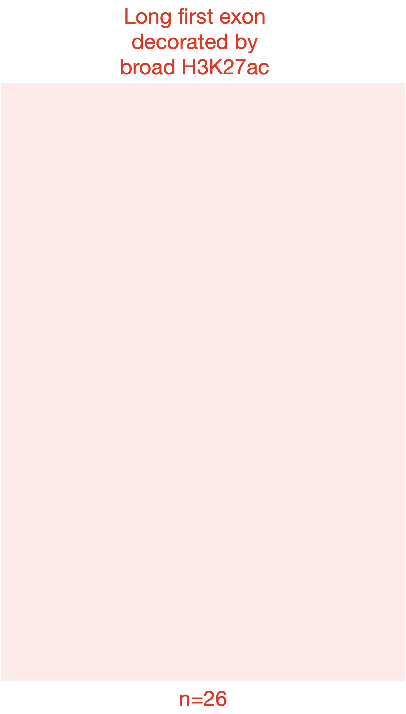
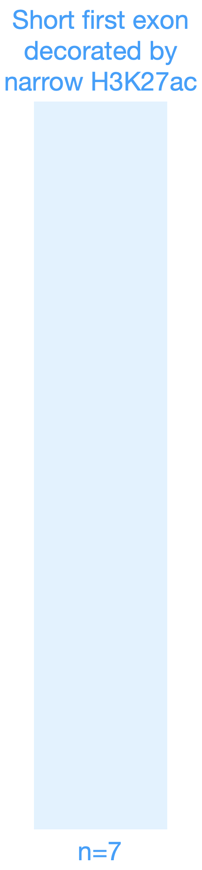
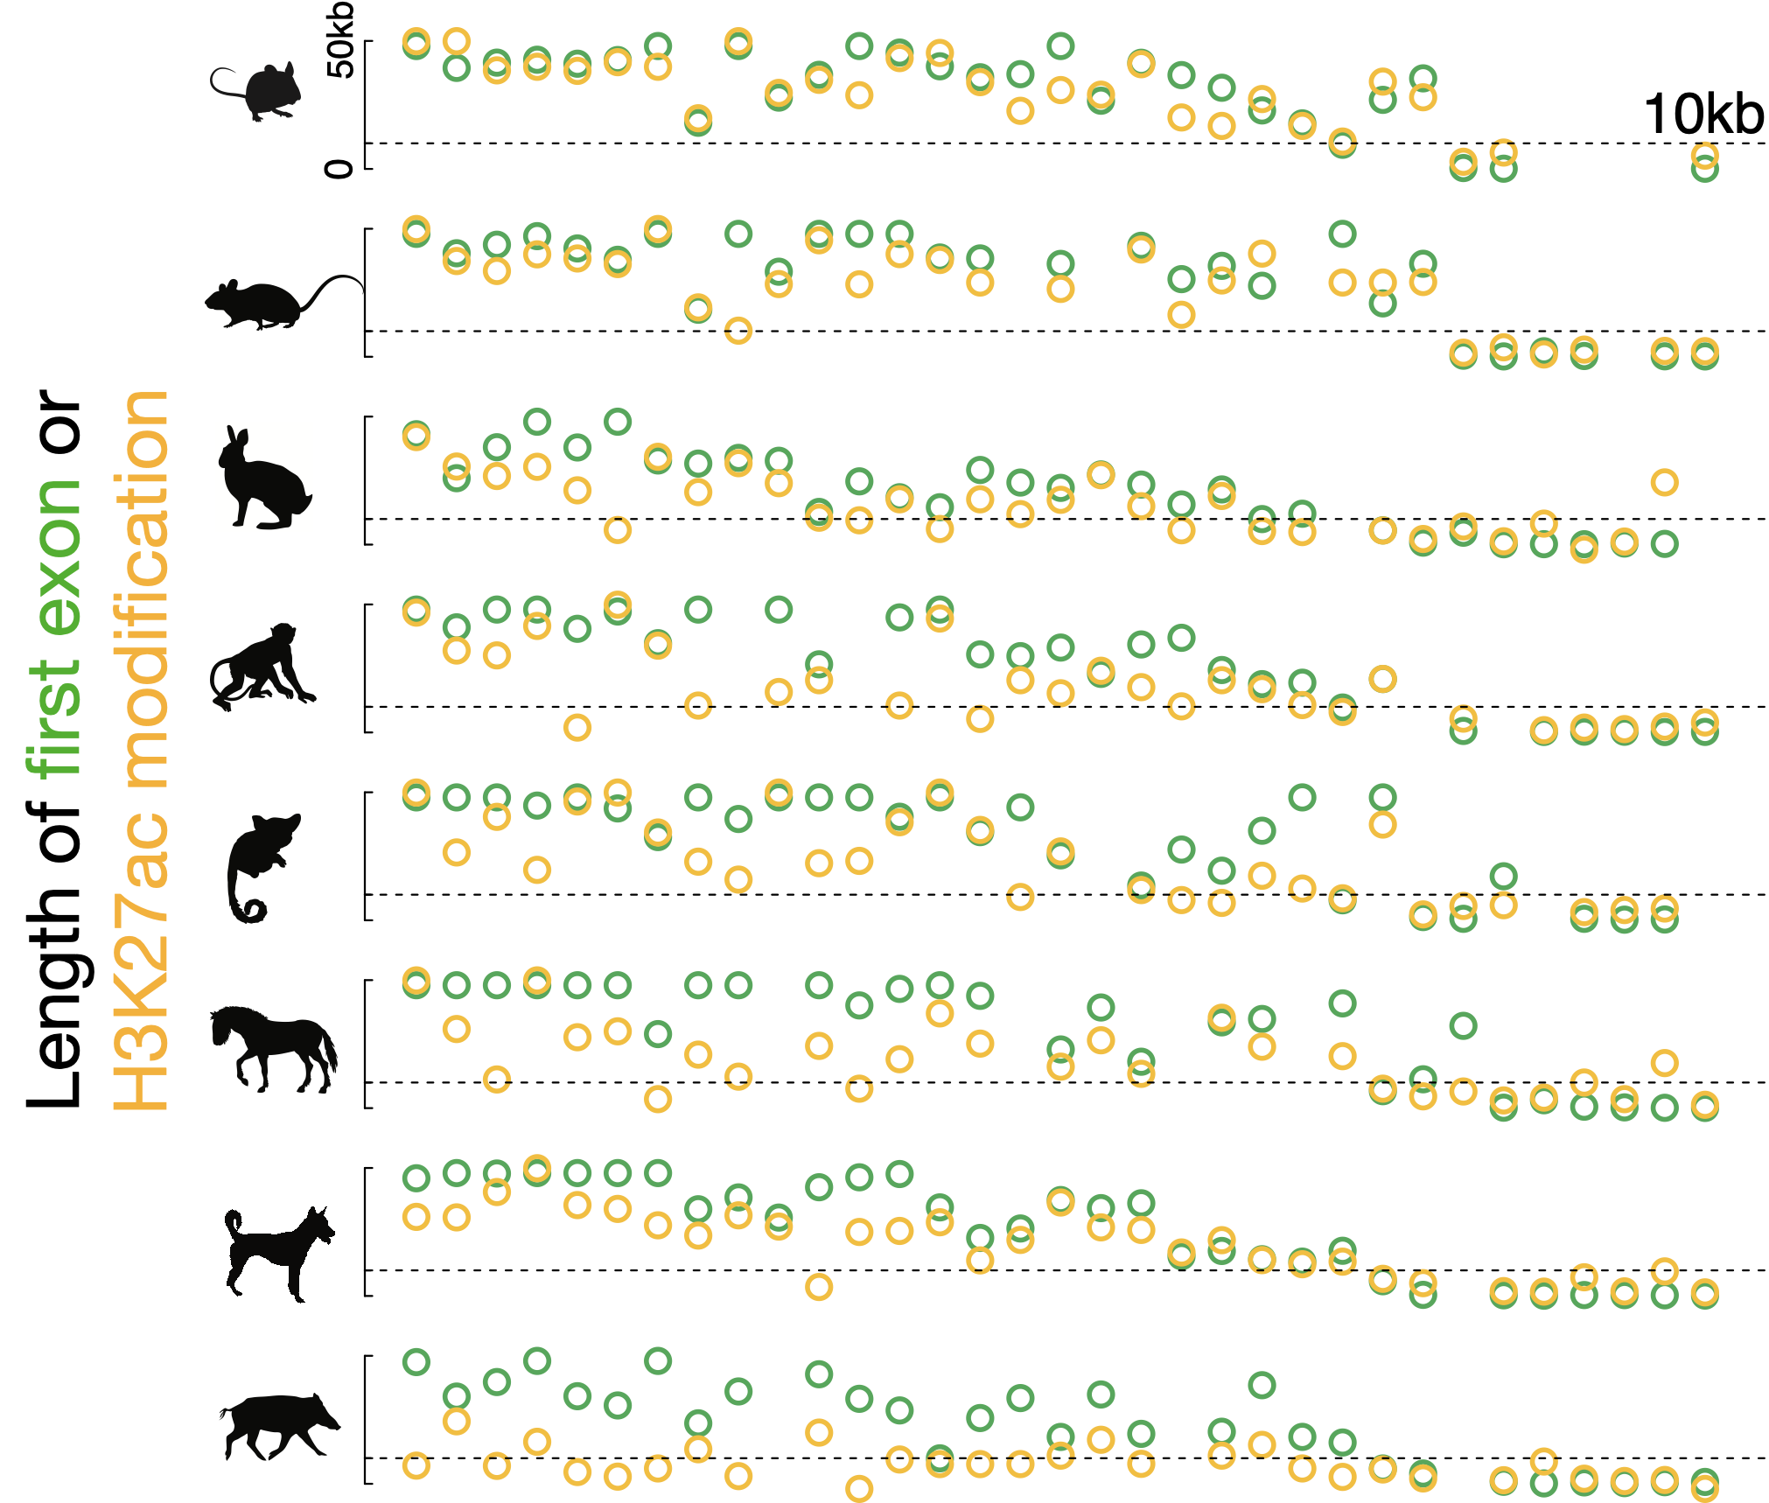
Long first-exon and broad H3K27ac are conserved among eutherian mammals
Results
Percent long-first-exon pachytene loci
conserved and broad H3K27ac
100%
80%
60%
40%
20%
0%
Unpublished
Tianxiong Yu, Weng Lab
Apr 2022, the EMBO piRNA workshop
Notes:
In total, we identified 33 loci that are conserved by synteny and expression in at least 7 of 9 mammals. For each locus, we determined the length of the first exon and the breadth of H3K27ac signal in each mammal, shown as green and yellow circles in the left panel. We found that 26 genes have long first exons and broad H3K27ac that are above 10 kilo base pairs in most of the eight mammals, also, there are seven genes with short first exons and narrow H3K27ac. The bar plot on the right summarizes the 26 long-first-exon genes, and reveals a 75% conservation level.

Slide 15
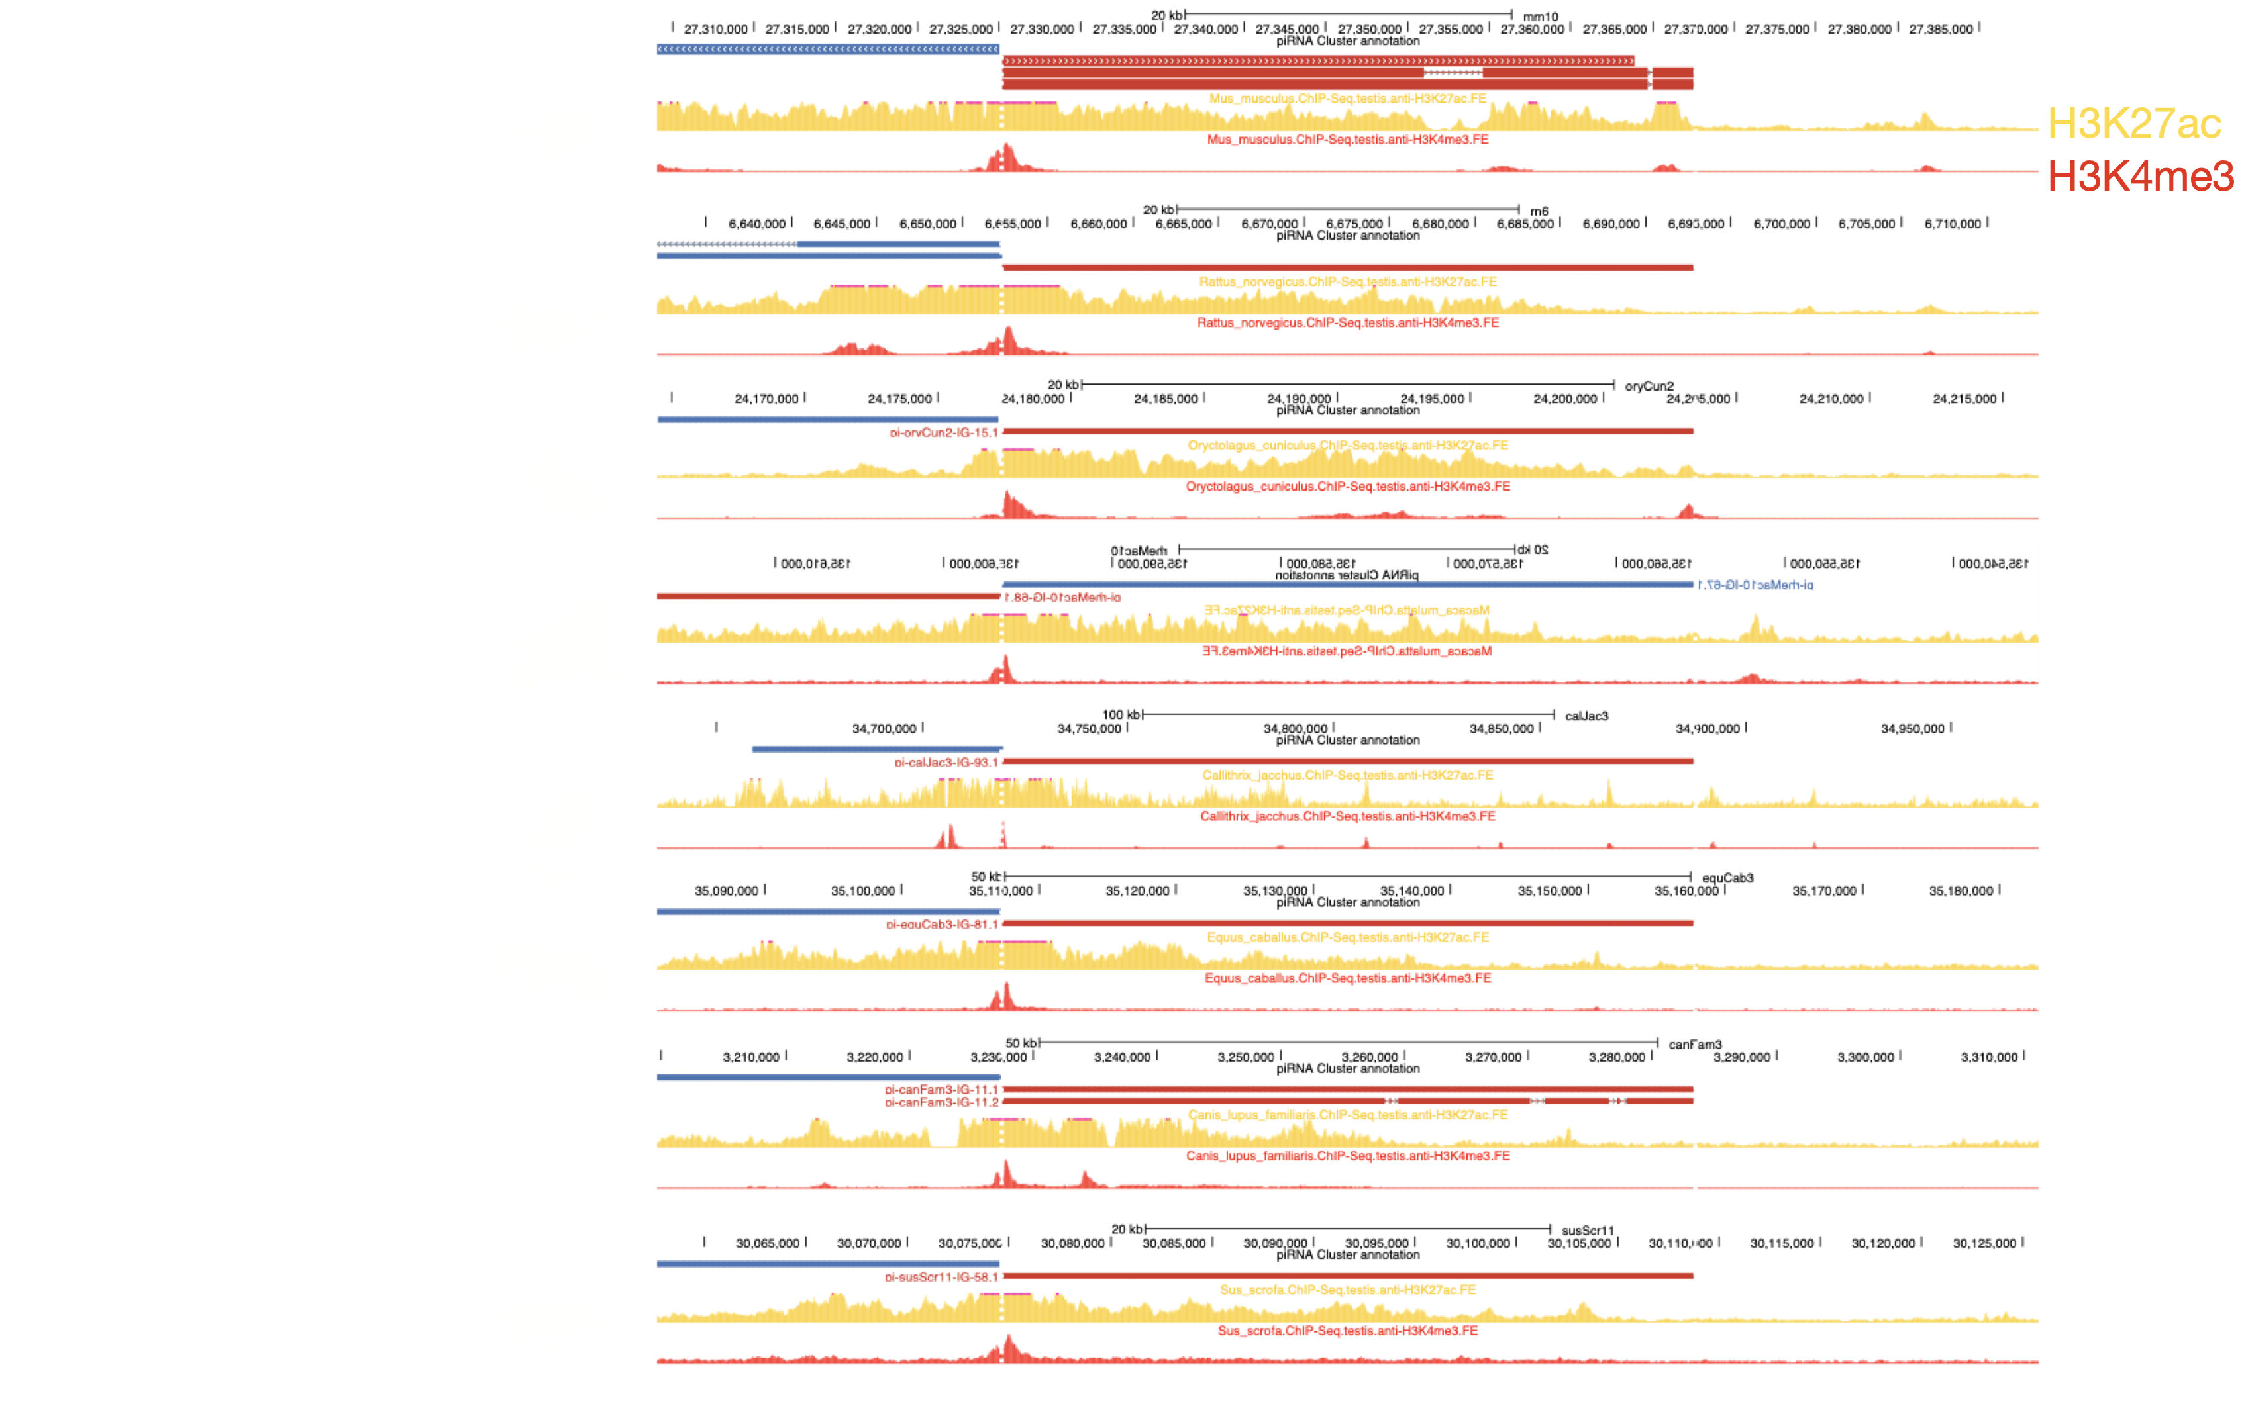
Notes:
For a better understanding, we then looked at the genome browser profile for all of the mammals. This is a long-first-exon pachytene piRNA gene that is conserved across the eight eutherian mammals, the TSS and TES have been aligned together and you can see the broad H3K27ac signals in yellow marks all mammals. For comparison, the H3K4me3 signal in red is focused on the promoter.

Slide 16
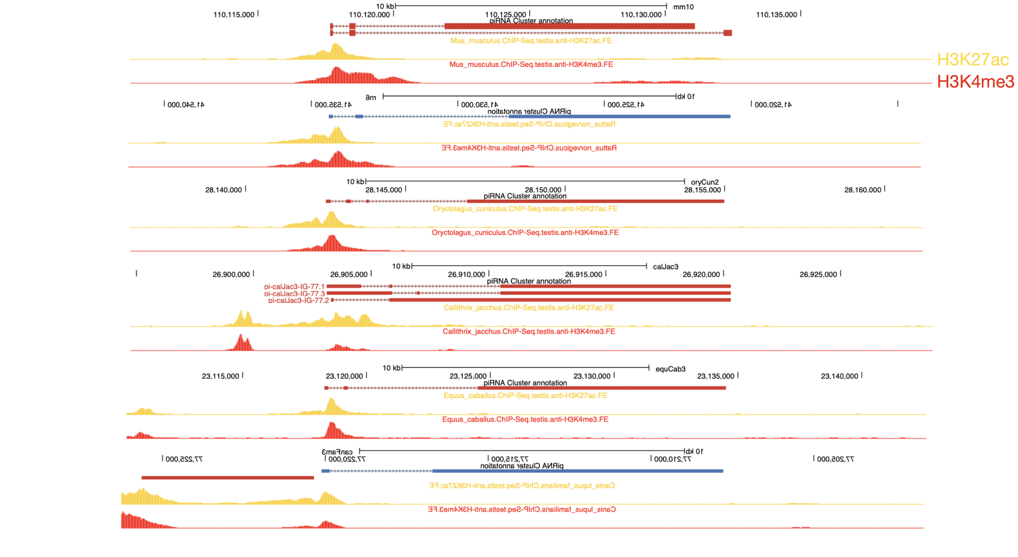
Notes:
This is a short-first-exon pachytene piRNA gene that is conserved across six mammals, and the length of first exon is consistently short in all mammals. Also, the K27ac signal is punctate in yellow across all mammals.

Slide 17

H3K27ac
Watson strand piRNA
Crick strand piRNA
Unpublished
Notes:
This is the divergently transcribed locus I showed earlier, and it is conserved in seven mammals. The long-first-exon piRNA gene is transcribed to the right, showing broad H3K27ac signals across the mammals along with abundant piRNAs production. But left gene DDX50, which are spliced, has no H3K27ac and piRNAs in any of the species.

Slide 18
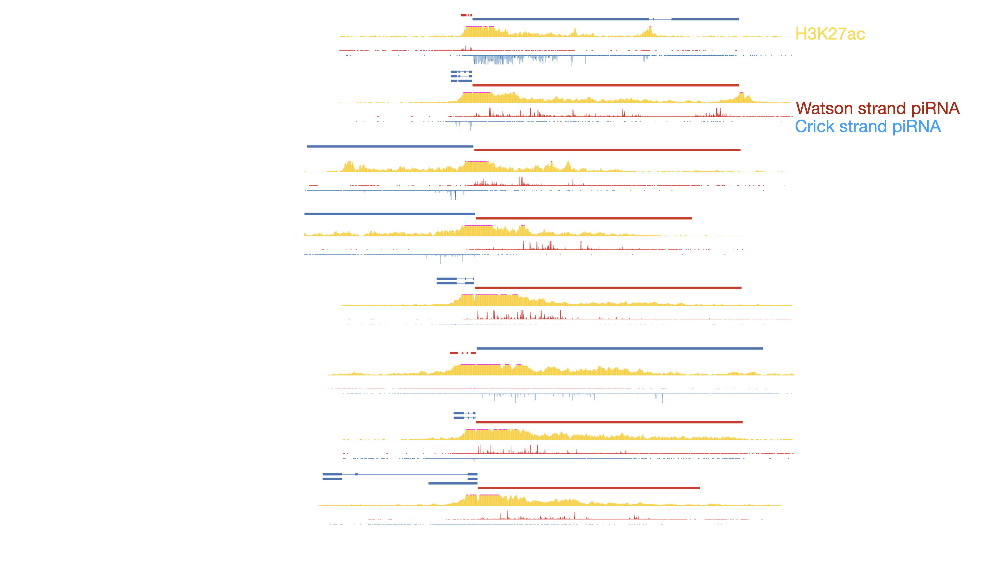
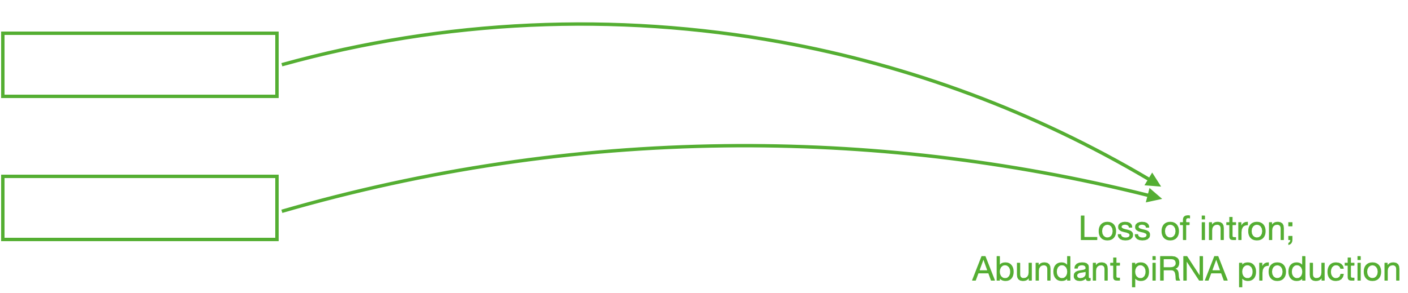
Notes:
Finally, this is a very unique example. When we first found how important the long first exon is for piRNA precursor recognition, we were keeping think: what if a short first exon gene lost its intron and become a long first exon one. Can they be now processed into the piRNA biogenesis pathway and make piRNAs?
So, this is a bidirectional pachytene piRNA gene, where the right gene have long first exon and make tons of piRNAs in all eutherian mammals. But specifically, the left gene is spliced in the eutherian ancestor, and short first exon is observed in all these animals except mouse and rat. Although these spliced genes also make piRNAs, the abundance is way more less than the right arm genes, which is only hundreds of rpm shown in the name after the dash.
Surprisingly, the short first exon gene has lost its intron in mouse and rat, which diverged from the rabbit about 75 million years ago. And after then it become a long first exon pachytene piRNA gene, extensive H3K27ac starts to decorate the whole gene and it makes much more piRNAs; which again, implicated how splicing affects piRNA biogenesis from the evolutionary angle.

Slide 19
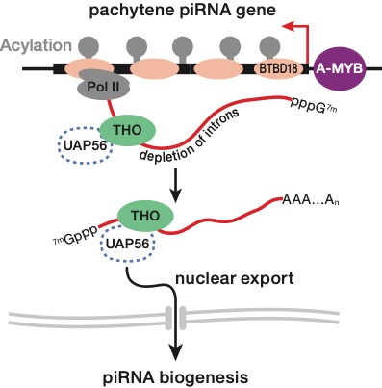
Summary
Long first-exon is a common feature of the 33 eutherian-conserved pachytene piRNA loci, which produce most pachytene piRNAs.
These long-first-exon pachytene piRNA loci show broad H3K27ac in the testes of seven eutherian mammals with such data.
The transcripts of these long-first-exon pachytene piRNA loci are bound by the THO complex in mice, likely important for steering them for processing.
Tianxiong Yu, Weng Lab
Apr 2022, the EMBO piRNA workshop
Notes:
In summary, I have told you some rather unusual features of a subset of pachytene piRNA genes that are conserved across eutherian mammals. Collectively, these genes make more than half of the piRNAs in the adult testes of these mammals. They have very long first exons and are broadly histone acylated. We don’t have THO binding in other mammals but we suspect that this is also a conserved feature.

Slide 20
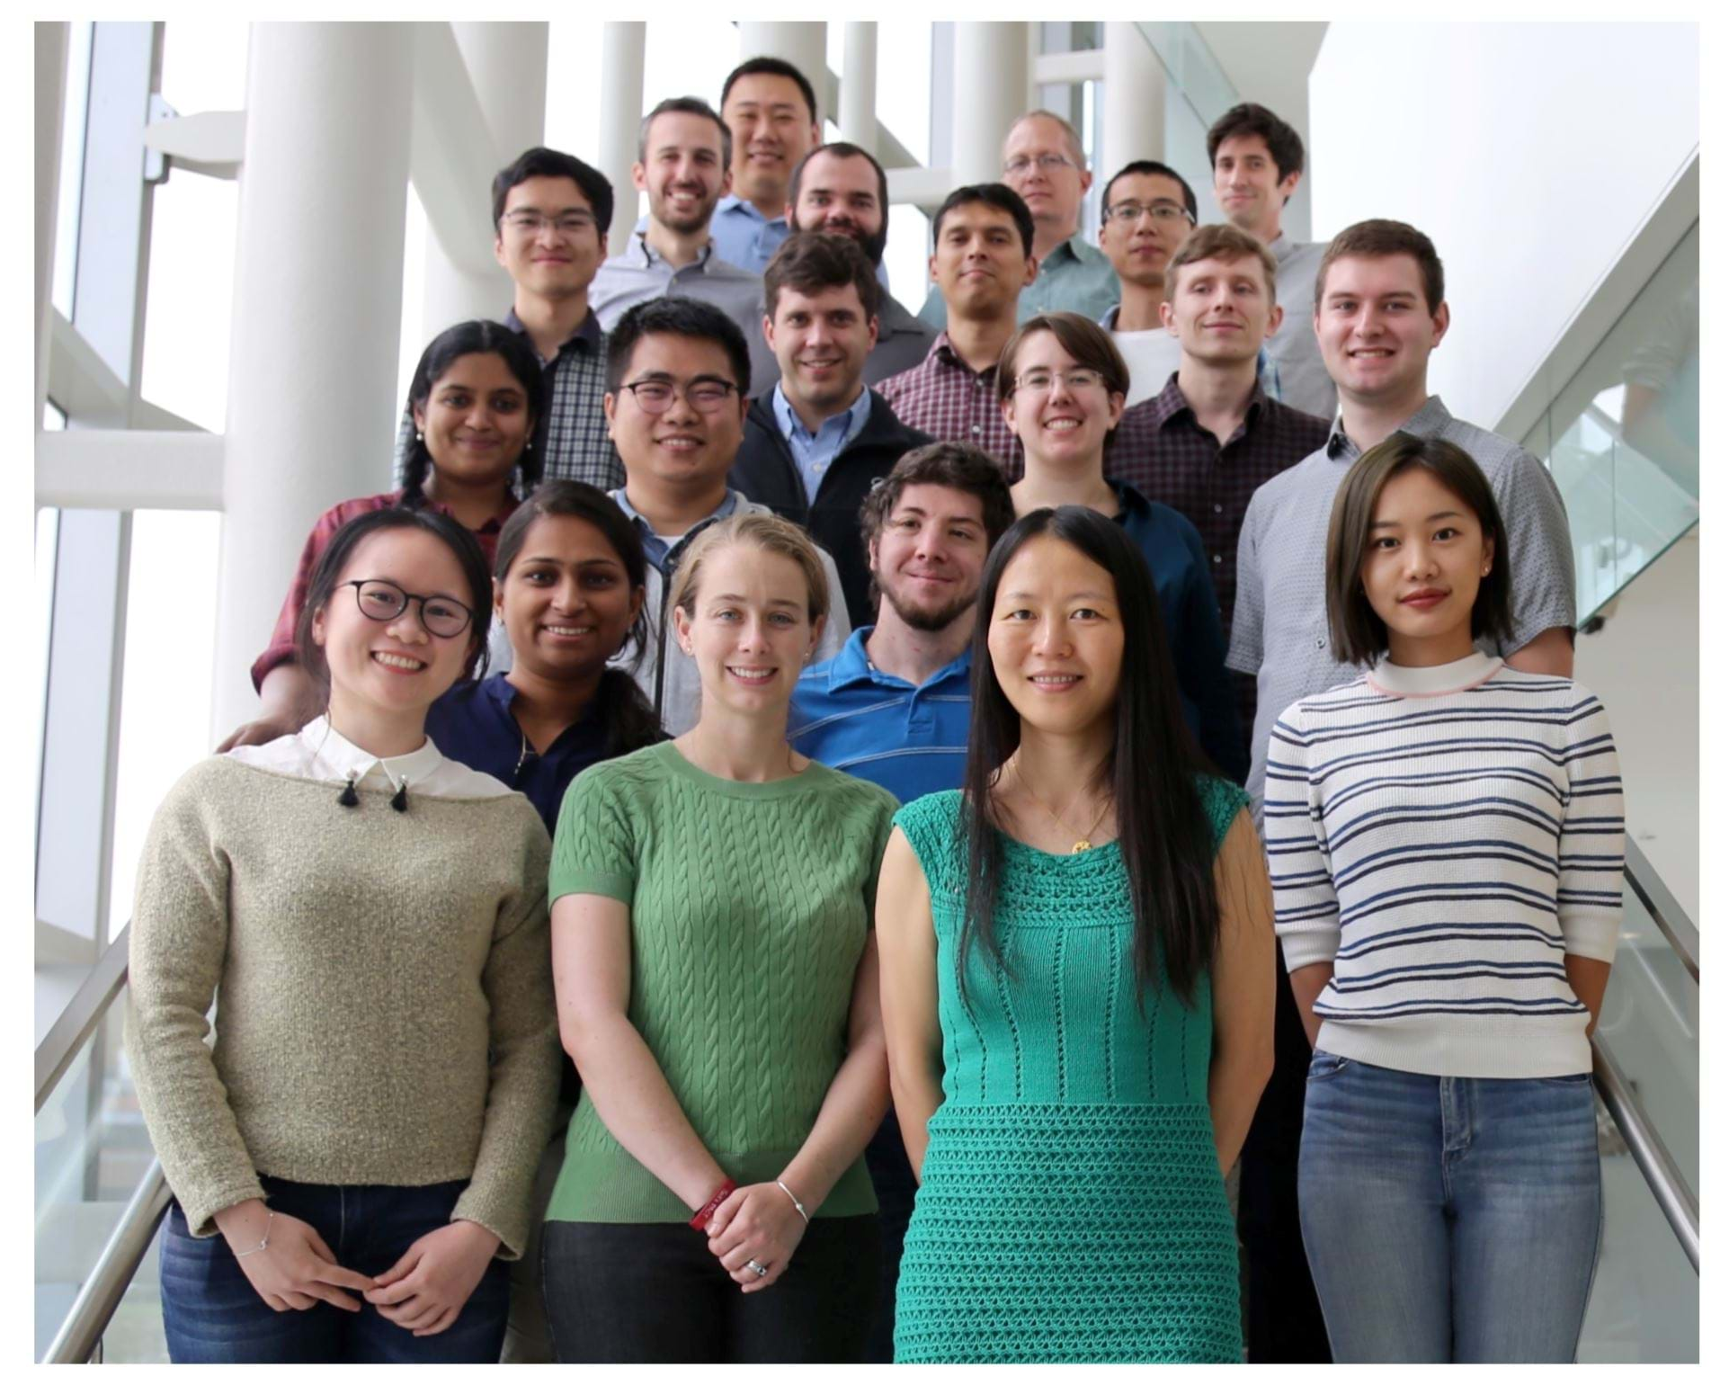
Acknowledgements
Thanks to all the collaborators!
Zhiping Weng
Phil Zamore
Bill Theurkauf
Kaili Fan
Deniz Ozata
Gen Zhang
Bo Xu
Zhongren Hu
Tianxiong Yu, Weng Lab
Apr 2022, the EMBO piRNA workshop
Notes:
Finally, I would like to thank all the people who have guided me, produced the data, and helped with the analysis in this project. I also want to thank the conference committees. And thank you all for your attention; I am happy to take any questions.

